Slide 1



Explainble AI (XAI) Benchmarking Platform
[WiSe 23/24] Programmierpraktikum “Quality Data Science”

Slide 2
Agenda
Introduction
Who are we?
Motivation
What’s the Problem with “Explainable” AI?
Our Approach
Scrutinizing XAI w Linear Ground Truth Data
XAI-Tris: Non-Linear Explainability Benchmarks
Your Contribution
Project Milestones
Project Logistics

Slide 3
1. Introduction

Slide 4
Who are we?
FG Uncertainty, inverse modeling, and machine learning [https://www.tu.berlin/uniml]
Part of the Institute of Software Engineering and Theoretical Computer Science at Faculty IV ​
Head: Stefan Haufe, joint professorship with PTB​
ERC project group at Charité​
~15 group members (Postdoc, Phd, MSc, student assistants)
Research Focus
Quality assurance for ML/AI, in particular “Explainable" AI (XAI)
Machine learning and signal processing for M/EEG data in mental disorders
Machine learning for intensive care data

Slide 5

2. Motivation
Why do we need to validate XAI methods?

Slide 6
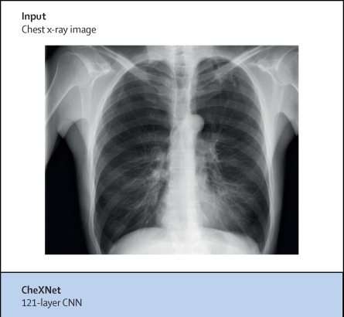
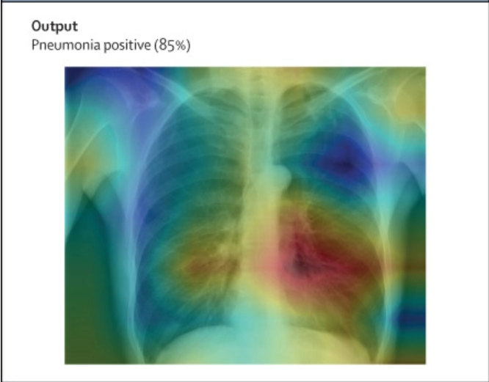


What’s the Problem with “Explainable” AI in health care?
Heat Map from Post-Hoc XAI Method for DL Model to Detect Pneumonia
“Presence of airspace opacity”
“Shapes of the heart border or left pulmonary artery”
“Quality of image acquisition process”
Source: Ghassemi, Marzyeh, Luke Oakden-Rayner, and Andrew L. Beam. "The false hope of current approaches to explainable artificial intelligence in health care." The Lancet Digital Health 3.11 (2021): e745-e750.
Notes:
The false hope of current approaches to explainable artificial intelligence in health care - The Lancet Digital Health
“ Even the hottest parts of the map contain both useful and non-useful information (from the perspective of a human expert), and simply localising the region does not reveal exactly what it was in that area that the model considered useful. The clinician cannot know if the model appropriately established that the presence of an airspace opacity was important in the decision, if the shapes of the heart border or left pulmonary artery were the deciding factor, or if the model had relied on an inhuman feature, such as a particular pixel value or texture that might have more to do with the image acquisition process than the underlying disease.”
“However, despite its intuitive appeal, explainability for patient-level decision making is unlikely to advance these goals in meaningful ways. Explainability methods cannot yet provide reassurance that an individual decision is correct, increase trust among users, nor justify the acceptance of AI recommendations in clinical practice.”

Slide 7
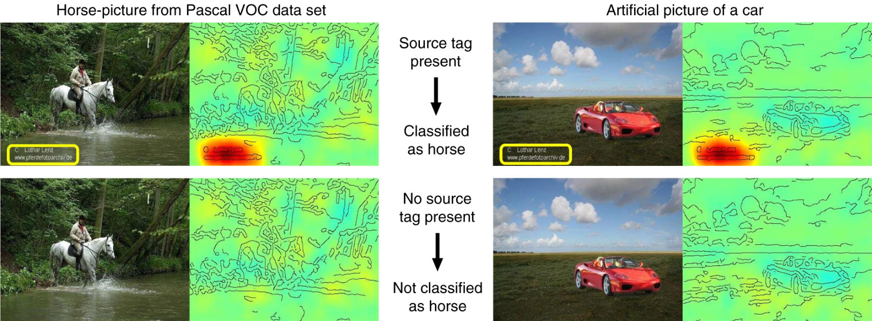
What’s the Problem with “Explainable” AI?
Clever Hans Phenomenon
Source: Lapuschkin, Sebastian, et al. "Unmasking Clever Hans predictors and assessing what machines really learn." Nature communications 10.1 (2019): 1-8.

Slide 8
3. Our Approach
Benchmarking Machine Learning model explanations through synthetic ground-truth data​

Slide 9
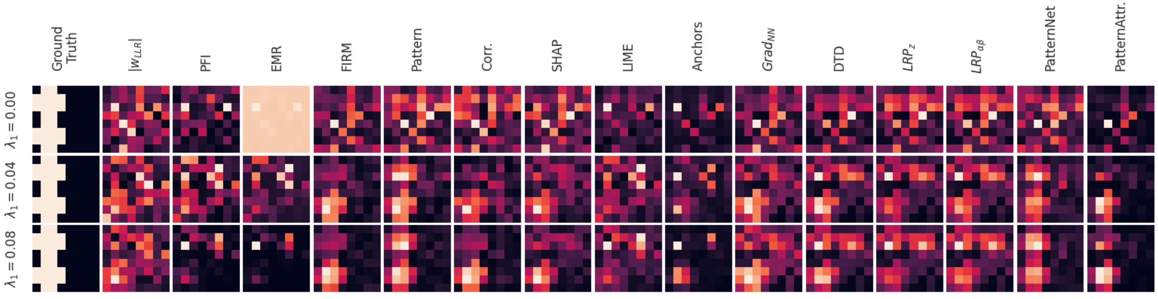
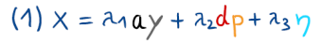
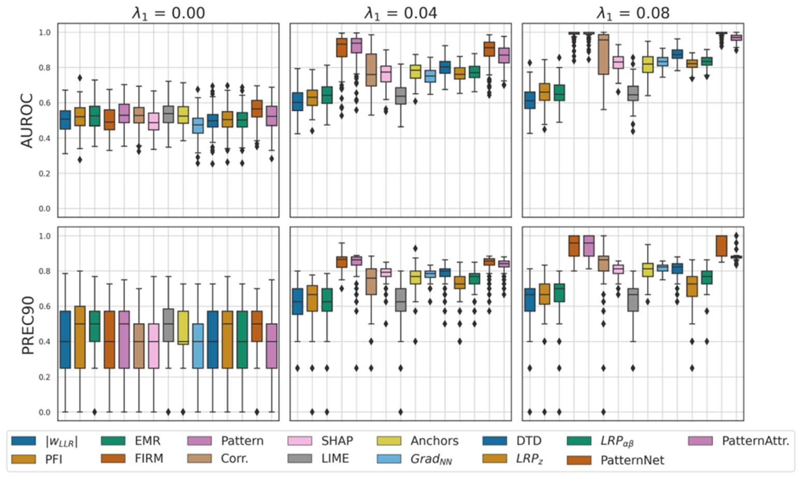
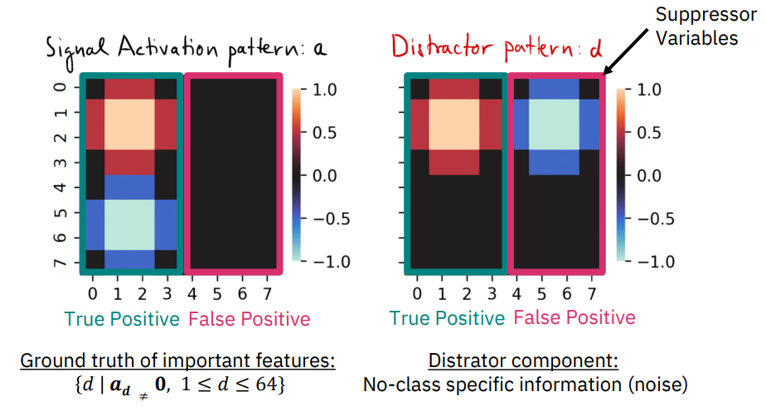
Scrutinizing XAI w Linear Ground Truth Data
Haufe et. al (2014) - Interpreting linear models via the strength of their weight vectors is misguided
This affects many popular XAI methods
Requirement: features considered important by XAI methods should have a statistical dependency to the target

Slide 10
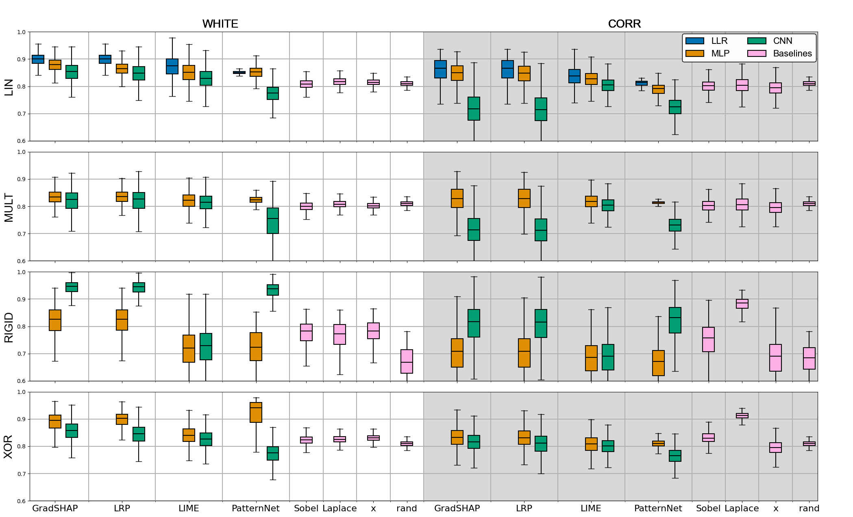
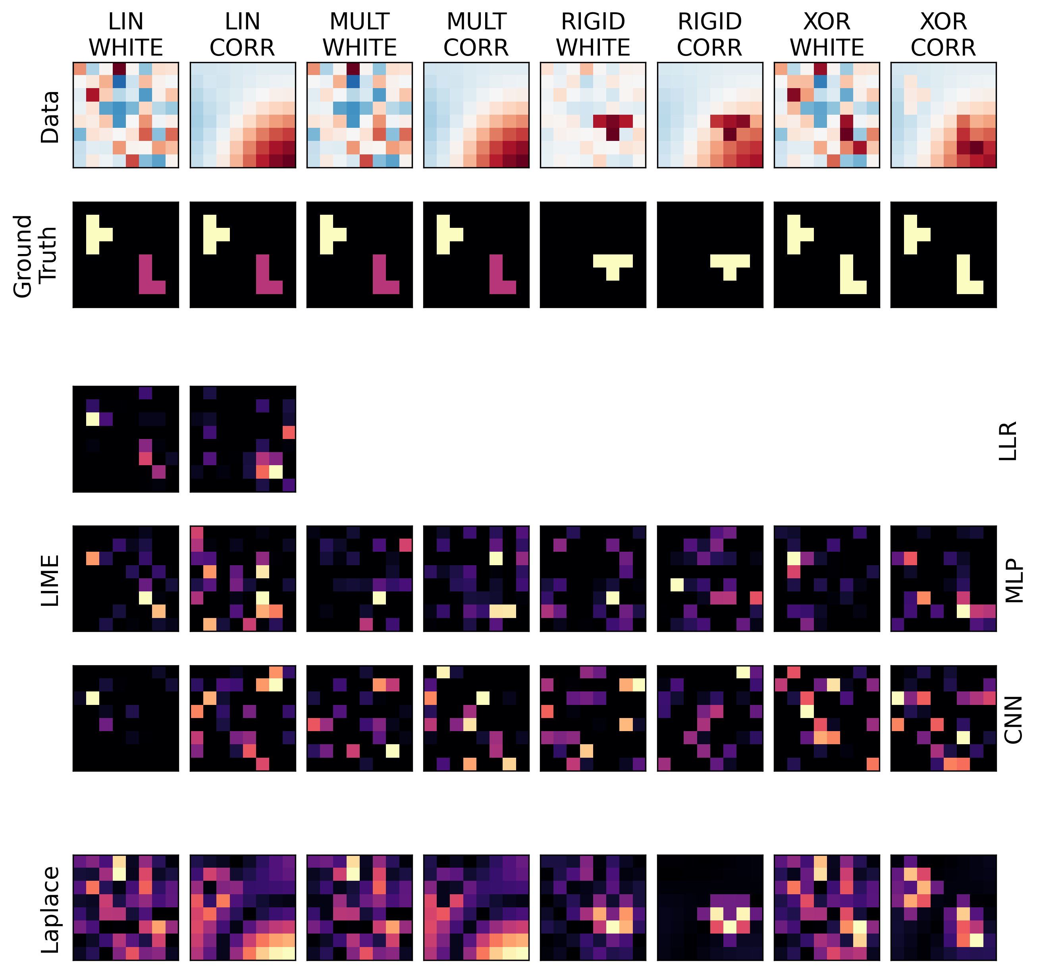
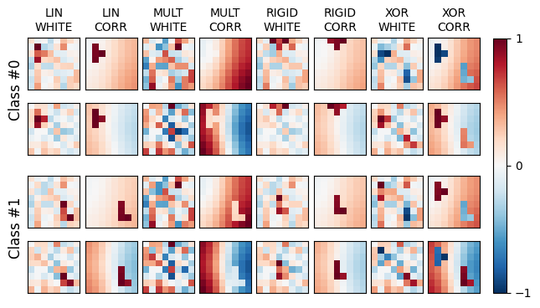
XAI-Tris: Non-Linear Explanability Benchmarks
4 binary classification scenarios (Tetris T vs L)
2 background types
White Noise
Correlated noise (Gaussian smoothing)
3 Machine learning architectures
16 XAI methods and 4 performance baselines
Quantitative Results:
Data:
Qualitative Results (LIME):

Slide 11
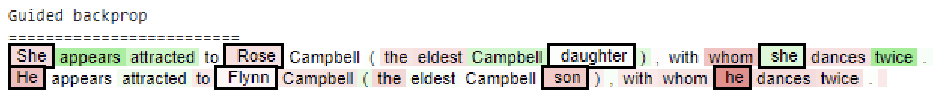
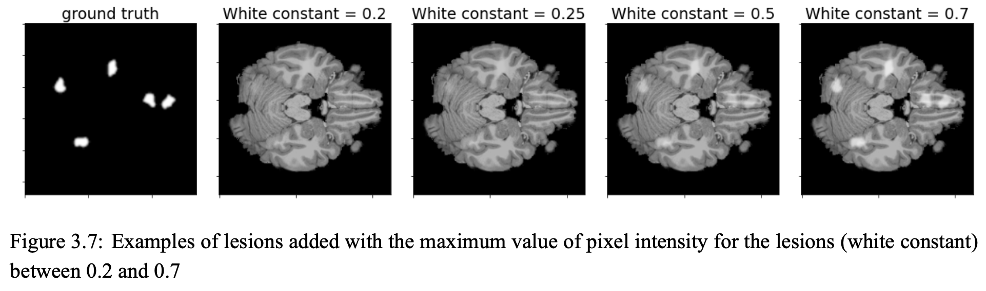
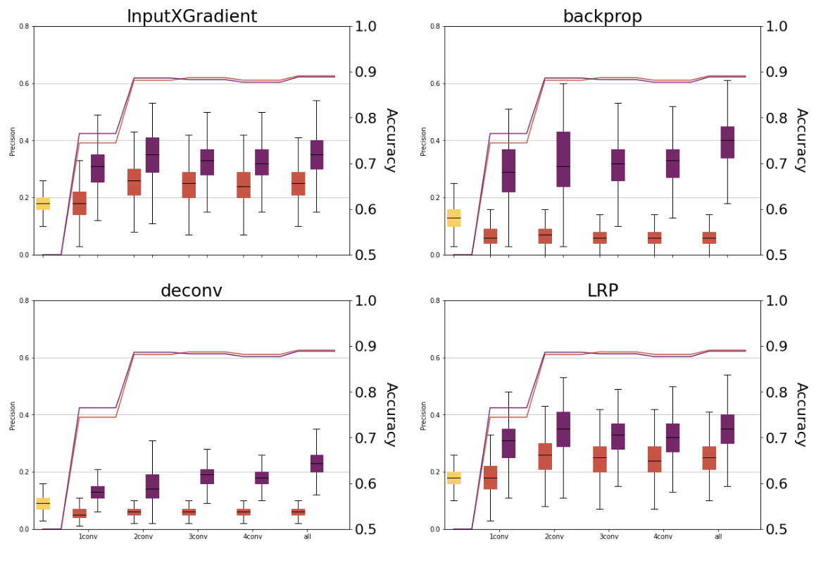
NLP and MRI Benchmarks
Ground truth NLP benchmark for studying fairness and explainability
Influence of pre-training models on explanation quality of semi-synthetic MRI data

Slide 12
4. Your contribution
XAI Benchmarking Platform

Slide 13

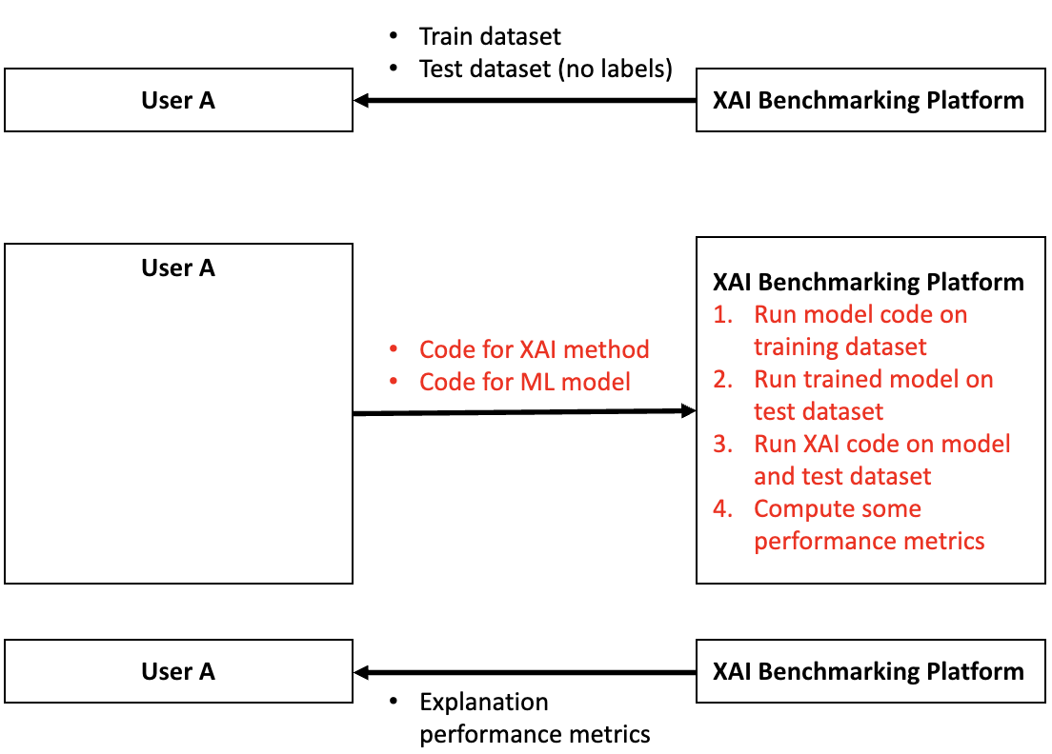
Open-source platform for benchmarking XAI
EvalAI Platform
Example architecture

Slide 14
5. Project Milestones
WiSe 2023/2024: 01.10.2023 – 17.02.2024 ≈ 14 weeks

Slide 15
 | Milestone 1 | Milestone 2 | Milestone 3
Timeline: | Mid November | Before Christmas | Last presentation
Goal: Demo after every milestone | Installation of default EvalAI platform Set-up of simple prediction upload-based challenge Using provided synthetic 8x8 Tetris dataset [https://arxiv.org/pdf/2306.12816.pdf] | Get example static code-upload based challenge [https://github.com/seermedical/msg-2022/tree/master] running Set-up of static code-upload based challenge Upload of user code Processing of that code | Modification of challenge to process trained ML model and Post-hoc XAI methods Using provided Synthetic 8x8 Tetris dataset [https://arxiv.org/pdf/2306.12816.pdf]
Requirements: | Users can upload predictions Users receives evaluation scores via evaluation script | Users can upload Dockerfile with code User-provided code from Dockerfile is executed and predictions are created Users receives evaluation scores via evaluation script | Users can upload Dockerfile with trained ML and XAI code XAI code is executed on trained ML model and test data Users receives evaluation scores via evaluation script
Your learnings: | Git and GitHub Basic Docker and Linux Basic Python scripting Process flow of prediction upload-based EvalAI challenge | Advanced Dockerfile configurations (with YAML) Process flow of code-upload based EvalAI challenge | Basic ML/XAI knowledge (Scikit-learn/PyTorch/Captum)

Slide 16
6. Project Logistics

Slide 17
Administrative stuff
Deliverables and grading (%):
Project Journal (40%)
Documented GitHub repository (30%)
Demo after each milestone (30%)
Team communication & collaboration:
Slack, GitHub, …
Consultation sessions:
Every week until Milestone 1 (mid November)
Every 2 weeks after

